Slide 1
DesertNET International, DNI
Working Group (WG) Coordinators
Kick Off Meeting with DNI Management
Dr. Kakha NADIRADZE
Chair
22 July, 2024

Slide 2
Working groups of dni
Working Group Climate Change, Soils Restoration Agroecology, and Biodiversity Dr. Nausheen Mazhar | Working Group Satellite Mapping WG (Database, Spatial, Digital tools, Interactive maps Dr. Seyed kazem Alavipanah | Working Group Position Papers. Scientific-Research Publications/Articles/Newsletters editing PhD. Student Chiara Ceseracciu | Working Group Fundraising and Research Projects (Horizon Europe, JRC, RFIS, Conferences, workshops Dr. Fei WANG | Working Group Young Scientists and Ph.D. Studen ts Prof. Giovanna Seddaiu

Slide 3
Climate Change, Soils Restoration, Agroecology, and Biodiversity WG
This group focused on understanding and addressing issues related to climate change impacts in desert regions, soil restoration techniques, sustainable agriculture practices (Agroecology), and biodiversity conservation.

Slide 4
Satellite Mapping WG (Database, Spatial, Digital tools, Interactive maps) WG
This group deals with utilizing satellite imagery and digital tools to map and monitor desert regions, including the development of interactive maps and spatial databases.

Slide 5
Position Papers, Scientific Research Publications/Articles/Newsletters Editing WG
This group is involved in drafting position papers, editing scientific research publications, articles, and newsletters related to desert ecology, management, and research findings.

Slide 6
Fundraising and Research Projects WG
This group is responsible for identifying funding opportunities (such as Horizon Europe, JRC, TAIEX, RFIS) and organizing conferences, workshops, and other events to support desert research and collaboration.

Slide 7
Young Scientists and Ph.D. Students WG
This group focused on supporting young researchers and PhD students within DesertNET International, providing mentorship, networking opportunities, and support for their research initiatives.

Slide 8
Outcomes & short-term and long-term benefits
The Working Groups (WG) are instrumental in fostering collaboration, sharing knowledge, and advancing research and initiatives related to desert ecosystems and sustainability.
Each group plays a crucial role in contributing to the broader goals of DesertNET International.

Slide 9
Combating Desertification: A Global Challenge
Preserving Our Ecosystems
Desertification is the process of land degradation in arid, semiarid, and dry sub-humid areas due to various factors, including climate change and unsustainable human activities.
Preserving ecosystems is crucial for maintaining the delicate balance of our planet.

Slide 10
Understanding the Causes of Desertification
The primary causes of desertification include overgrazing, deforestation, unsustainable agricultural practices, and climate change.
These factors lead to the loss of vegetation, soil erosion, and the degradation of land, ultimately threatening the livelihoods of communities and the biodiversity of these regions.

Slide 11
Innovative Solutions for Combating Desertification Science Based and Nature based Solutions integrated with Digital Solutions
Sustainable land management practices, such as agroforestry, conservation agriculture, and land restoration, can help mitigate the effects of desertification.
These approaches aim to improve soil fertility, enhance water retention, and promote the growth of vegetation, thereby preserving the delicate balance of fragile ecosystems.

Slide 12
TOWARD A SUSTAINABLE FUTURE: COMBATING DESERTIFICATION
By addressing the root causes of desertification and implementing a holistic, collaborative approach, we can preserve our fragile ecosystems and ensure a sustainable future for generations to come.
Continued research, policy development, and international
cooperation are essential in DNIs global efforts

Slide 13
Key takeaways:
Interdisciplinary Focus: Each working group addresses specific facets of desert research, from climate change and biodiversity to satellite mapping and soil restoration.
This interdisciplinary approach ensures a comprehensive understanding and effective management of desert ecosystems.
Collaborative Efforts: The working groups facilitate collaboration among experts, stakeholders, and young scientists, fostering a synergistic environment for knowledge exchange and innovative solutions.
Practical Applications: Groups like Satellite Mapping and Digital Tools emphasize the use of technology for mapping, monitoring, and managing desert landscapes, leveraging spatial databases and interactive maps for actionable insights.
Publication and Advocacy: The Position Papers and Publications Editing group plays a vital role in disseminating scientific findings, shaping policy through advocacy, and promoting awareness about desert-related issues.
Capacity Building: The focus on Young Scientists and PhD Students ensures continuity in research efforts by nurturing the next generation of desert researchers and providing them with mentorship and support.
Strategic Planning and Funding: The Fundraising and Research Projects group strategically pursues funding opportunities and organizes events like conferences and workshops, crucial for advancing research agendas and maintaining international collaborations.

Slide 14
We are committed to:
Ensure the sustainability outcomes which can deliver tangible benefits for our Members and for initiating new Projects, Programs and Policy Papers for all stakeholders and Farmers, ranchers, people and the planet.
This is critical for the development our collective actions toward of sustainable Soil Sciences in light of new approaches and result oriented coalitions and partnership through to enabling WGs activities more visible and feasible…
By contributing to DesertNET International's mission implementation within WGs by promoting sustainable desert management, conservation, and resilience through research, advocacy, and collaboration. They reflect a comprehensive approach to addressing complex challenges in desert regions worldwide.

Slide 15
Water-Soil-Food-Health Nexus
Certainly, desertification is closely correlated with agri-food systems due to several interconnected factors:
Land Use Change: Agricultural practices often involve clearing land for cultivation, which can lead to soil degradation and increased vulnerability to desertification, especially in arid and semi-arid regions.
Soil Erosion: Intensive agricultural practices, such as monocropping and overgrazing, can accelerate soil erosion. Erosion reduces soil fertility and water retention capacity, making the land more susceptible to desertification processes.
Water Management: Poor water management practices in agriculture, such as inefficient irrigation systems or excessive water extraction, can contribute to water scarcity and desertification in already arid areas.
Deforestation: Clearing land for agriculture can also involve deforestation, which disrupts ecosystems and reduces vegetation cover. This loss of vegetation accelerates soil erosion and reduces biodiversity, further exacerbating desertification risks.
Climate Change: Agriculture contributes to greenhouse gas emissions and is also affected by climate change impacts such as increased temperatures, altered precipitation patterns, and more frequent extreme weather events. These changes can exacerbate desertification processes in vulnerable regions.

Slide 16
Sustainable Agri-Food Systems
Addressing desertification within agri-food systems requires sustainable land management practices that aims to enhance soil health, conserve water resources, and promote resilient agricultural practices. Integrated approaches that consider both environmental conservation and agricultural productivity are essential to mitigate the impacts of desertification and ensure the long-term sustainability of agri-food systems in arid and semi-arid regions.

Slide 17
The Action Plan
Insights into Latest Thinking and Developments: Being part of such a coalition or communities for EU Grant Projects and Calls and stay updated on the latest research, strategies, and best practices, This could include new methodologies, case studies, policy developments, and innovative projects from our Members as bottom up incentives.
Newsletters and Project Updates: Membership often anticipates receiving monthly or quarterly newsletters and updates that provide valuable information on ongoing projects, upcoming events, and relevant news related to the DNIs Activities and community development. These updates can help us to stay informed and potentially participate in collaborative projects or initiatives.
Networking and Collaboration Opportunities: Being part of any International coalition offers networking opportunities with like-minded individuals and organizations. It can facilitate collaborations, partnerships, and the exchange of ideas that can further enhance your understanding and impact in the field of Membership Development and young Scientists engagement.

Slide 18
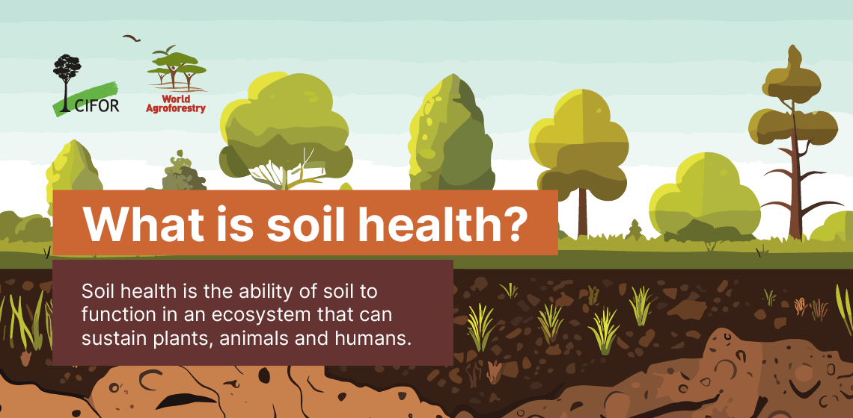
Thank you!

